Slide 2
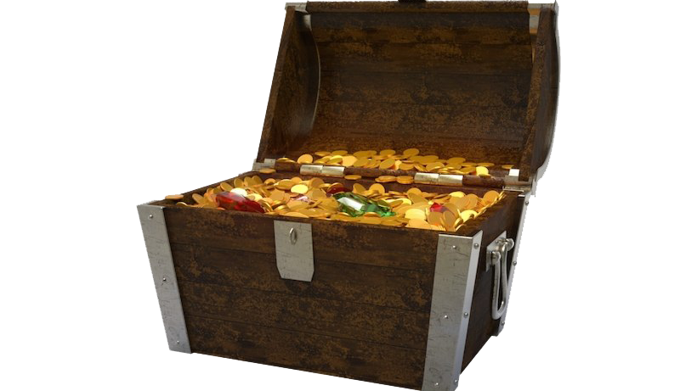

Slide 3
Chosen in Christ
“Before the world was created, God had Christ choose us…” – Ephesians 1:4 (CEV)

Slide 4
Chosen in Christ
“Before the world was created, God had Christ choose us…” – Ephesians 1:4 (CEV)
Saved from Sin’s Penalty
“…our sins are now forgiven.”
– Ephesians 1:7-8 (CEV)

Slide 5
Chosen in Christ
“Before the world was created, God had Christ choose us…” – Ephesians 1:4 (CEV)
Saved from Sin’s Penalty
“…our sins are now forgiven.”
– Ephesians 1:7-8 (CEV)
Eternal Inheritance
“…we will be given what God has stored up for his people.”
– Ephesians 1:14 (CEV)

Slide 22
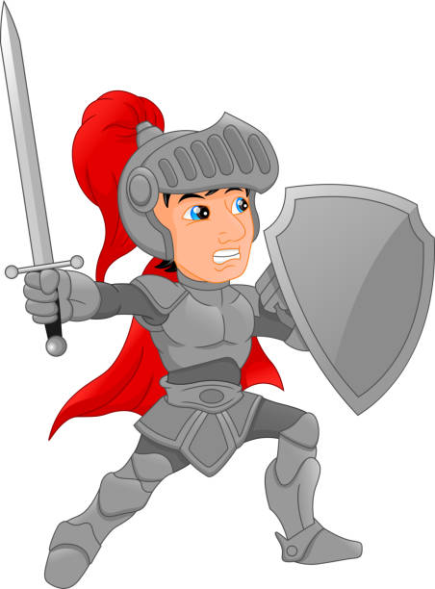

Slide 23
The Belt Of Truth
“Stand firm then, with the belt of truth…”
– Ephesians 6:14 (NIV)

Slide 24
The Belt Of Truth
“Stand firm then, with the belt of truth…”
– Ephesians 6:14 (NIV)
Breastplate Of Righteousness
“with the breastplate of righteousness in place”
– Ephesians 6:14 (NIV)

Slide 25
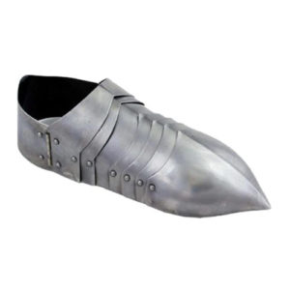
The Belt Of Truth
“Stand firm then, with the belt of truth…”
– Ephesians 6:14 (NIV)
Breastplate Of Righteousness
“with the breastplate of righteousness in place”
– Ephesians 6:14 (NIV)
Fitted Feet
“and with your feet fitted with the readiness that comes from the gospel of peace.”
– Ephesians 6:15 (NIV)

Slide 26
The Shield Of Faith
“take up the shield of faith, with which you can extinguish all the flaming arrows of the evil one” – Ephesians 6:16 (NIV)

Slide 27
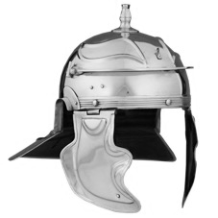
The Shield Of Faith
“take up the shield of faith, with which you can extinguish all the flaming arrows of the evil one” – Ephesians 6:16 (NIV)
The Helmet Of Salvation
“Take the helmet of salvation…”
– Ephesians 6:17 (NIV)

Slide 28
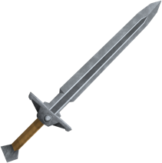
The Shield Of Faith
“take up the shield of faith, with which you can extinguish all the flaming arrows of the evil one” – Ephesians 6:16 (NIV)
The Helmet Of Salvation
“Take the helmet of salvation…”
– Ephesians 6:17 (NIV)
The Sword Of The Spirit
“and the sword of the Spirit, which is the word of God.”
– Ephesians 6:17 (NIV)

