Slide 1
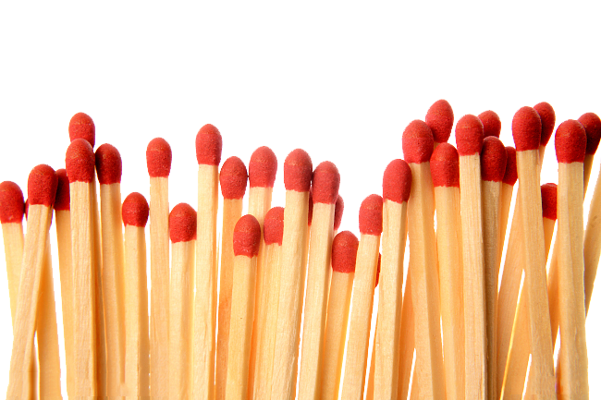
Perfect Match

Slide 2
In groups, give students a pile of headless matches OR toothpicks
Each group is to make the shape of the first image (shown on screen)
Attempt the challenge that’s also given on screen

Slide 3
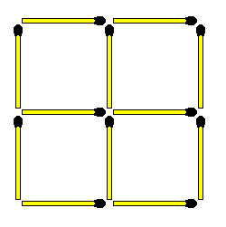
1.
Move 3 sticks to form 3 squares equal in size.

Slide 4
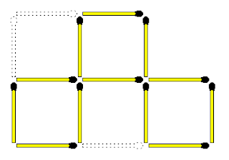
1.
SOLUTION

Slide 5
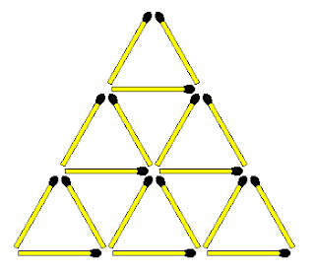
2.
TAKE AWAY 6 only sticks so that there are no triangles left.

Slide 6
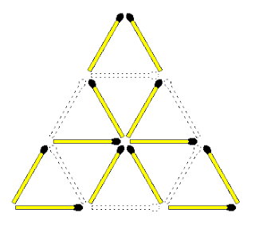
2.
SOLUTION

Slide 7
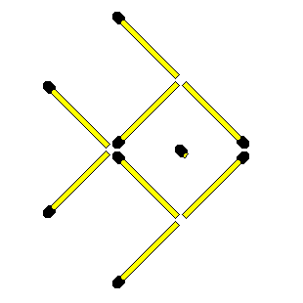
3.
The fish is swimming right. Move 2 sticks to make it swim down.

Slide 8
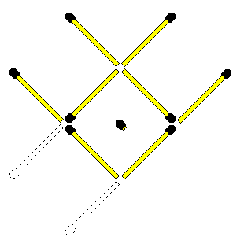
3.
SOLUTION

Slide 9
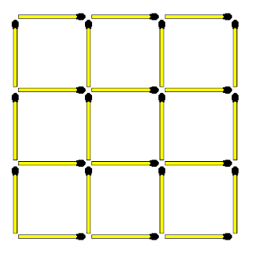
4.
Shown here are 14 squares in total. Remove 4 sticks to leave only 5 squares, all EQUAL in SIZE

Slide 10
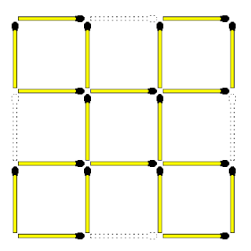
4.
SOLUTION

Slide 11
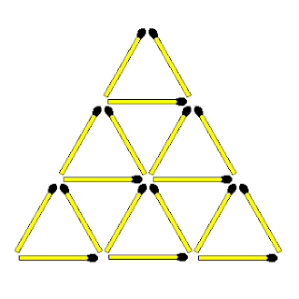
5.
Remove 3 sticks leaving 7 triangles. All the triangles don't have to be the same size.

Slide 12
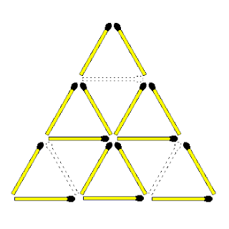
5.
SOLUTION

Slide 13
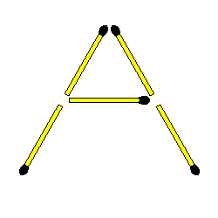
6.
The letter A was created by using 5 sticks. How would you create 2 A's by only using 4 sticks? All sticks don't have to be flat on the surface.

Slide 14
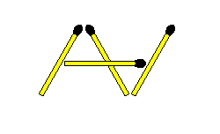
6.
SOLUTION

Slide 15
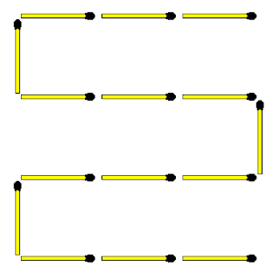
7.
Move 4 sticks changing the snake to 2 squares - not equal in size.

Slide 16
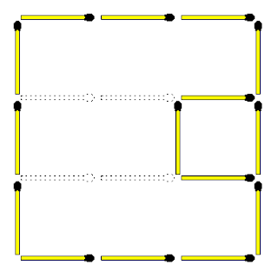
7.
SOLUTION

Slide 17
Perfect Match

