Slide 1
A Big Fish Story
Four studies from jonah

Slide 2
Week 1

Slide 3
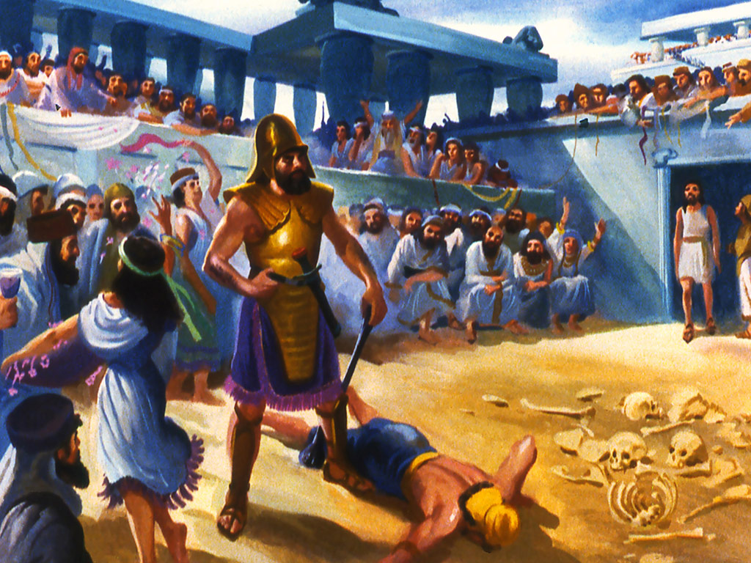
Week 1
EVIL ASSYRIANS
Image courtesy of: Moody Publishers / FreeBibleimages.org

Slide 4
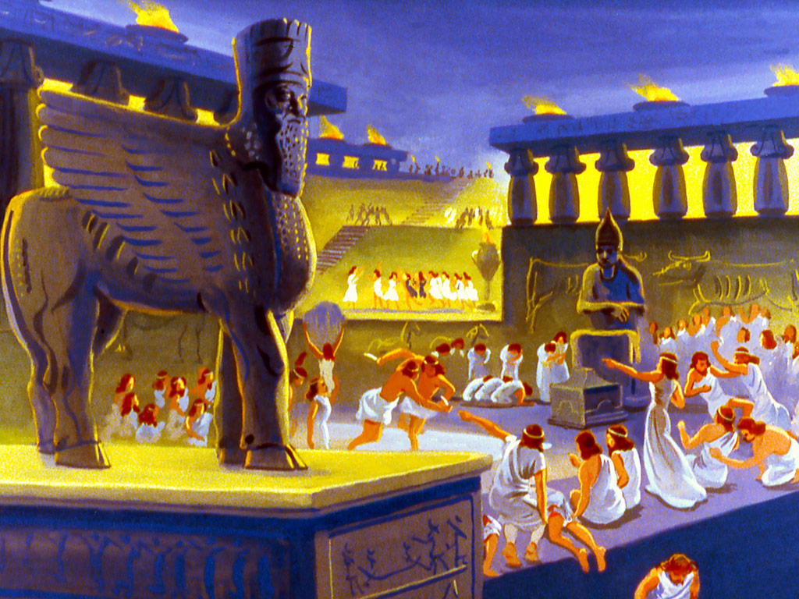
Week 1
WORSHIPING FALSE GODS
Image courtesy of: Moody Publishers / FreeBibleimages.org

Slide 5
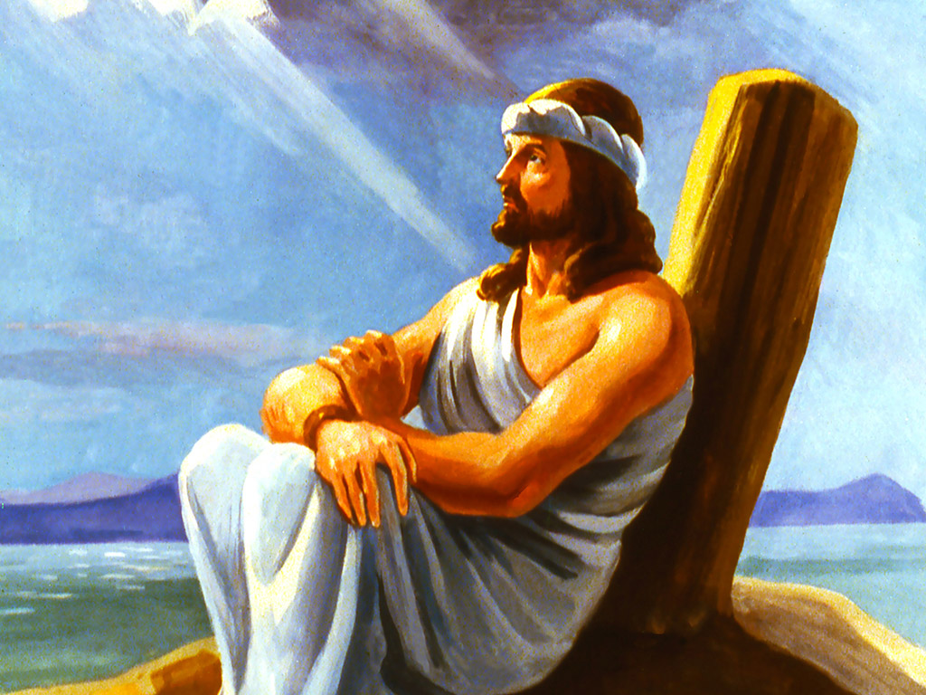
Week 1
JONAH
Image courtesy of: Moody Publishers / FreeBibleimages.org

Slide 6
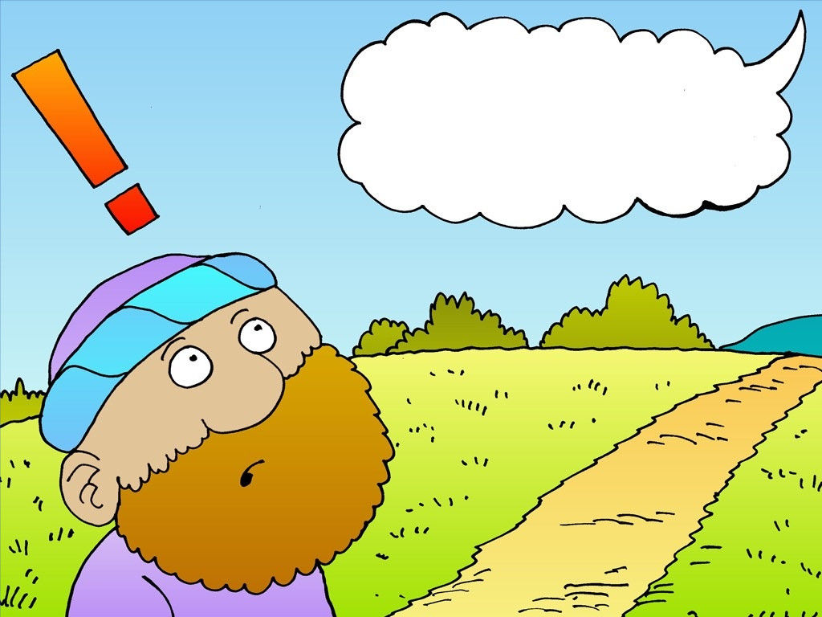
Week 1
JONAH HEARS GOD’S MESSAGE
Image courtesy of: Richard Gunther

Slide 7
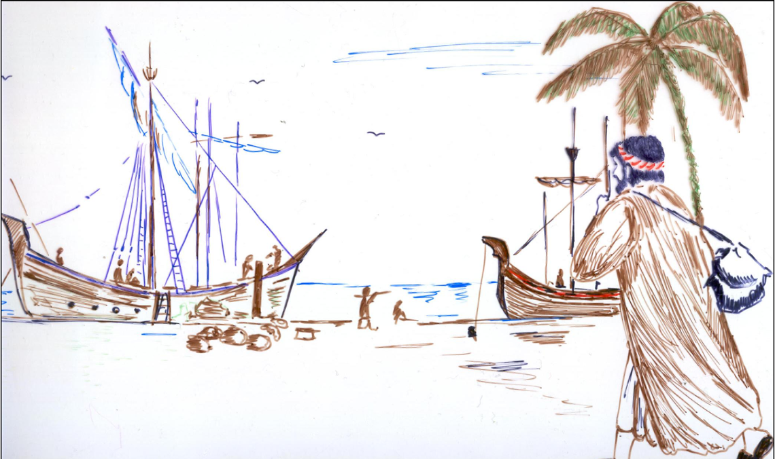
Week 1
JONAH RUNS FROM GOD
Image courtesy of: Max7

Slide 8
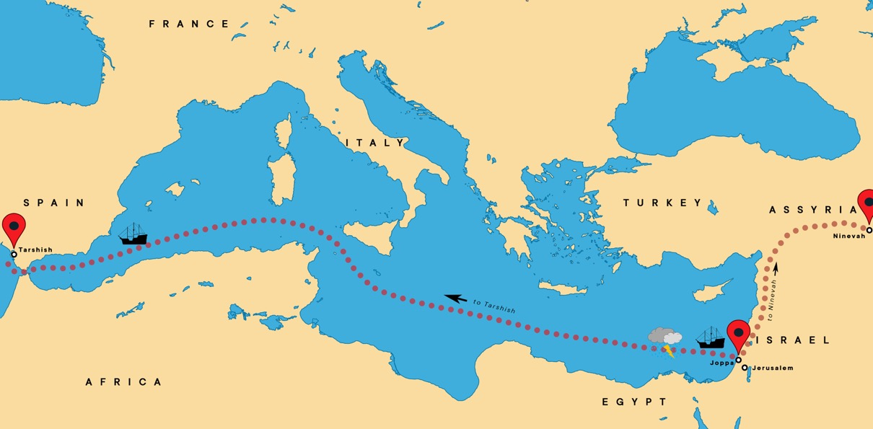
Week 1
JONAH HEADS TO TARSHISH

Slide 9
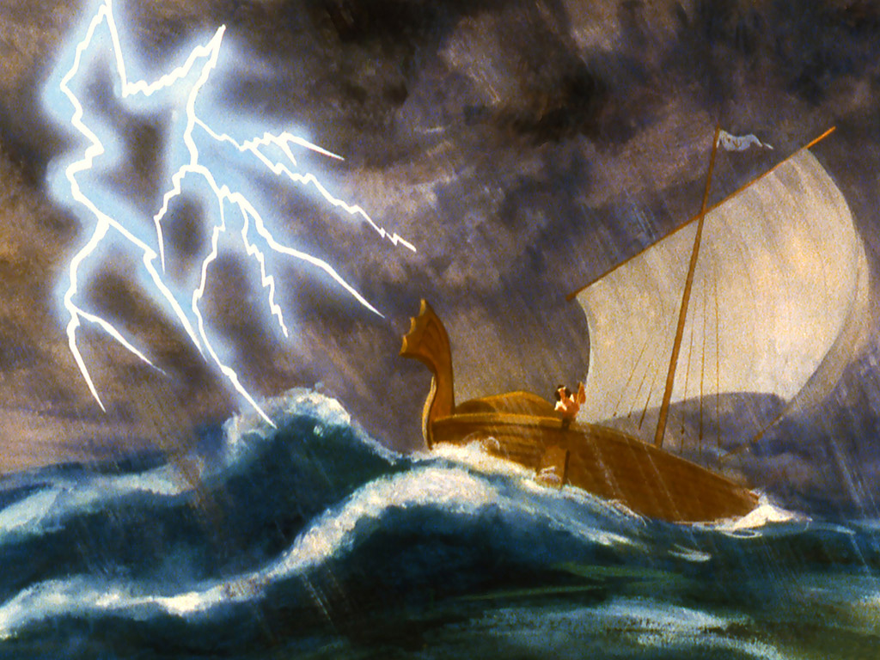
Week 1
THE STORM AT SEA
Image courtesy of: Moody Publishers / FreeBibleimages.org

Slide 10
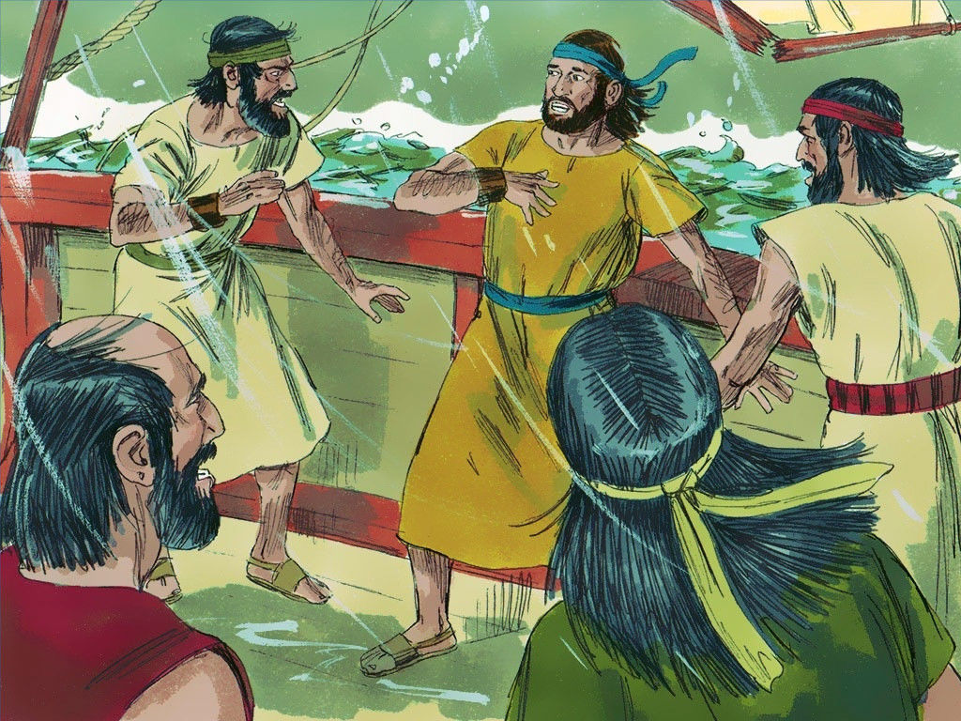
Week 1
“THROW ME OVERBOARD…”
Image courtesy of: Sweet Publishing / FreeBibleimages.org

Slide 11
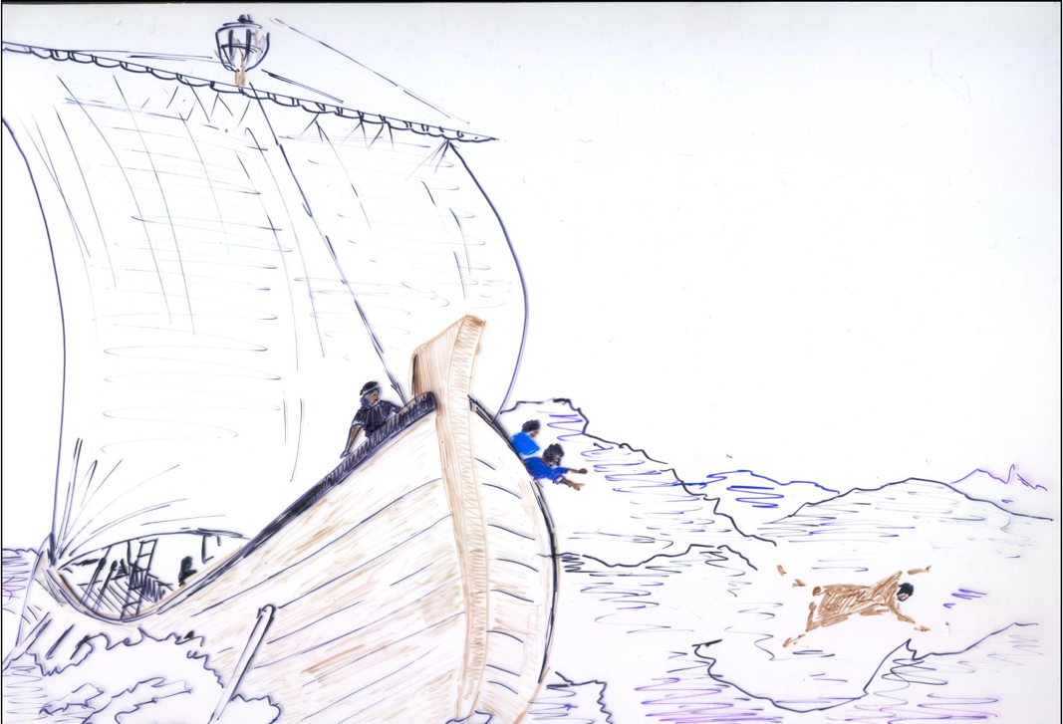
Week 1
JONAH THROWN OVERBOARD
Image courtesy of: Max7

Slide 12
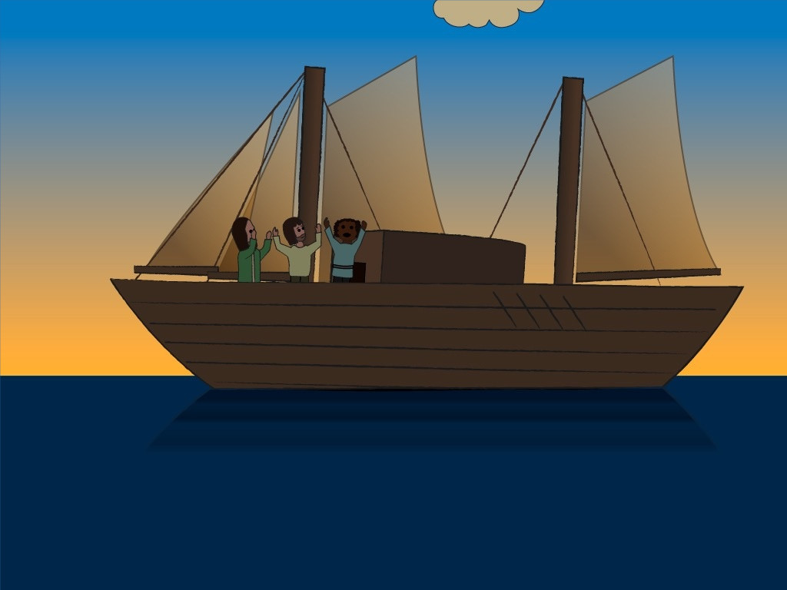
Week 1
THE SEA WENT CALM
Image courtesy of: Marian van der Kruijt

Slide 13
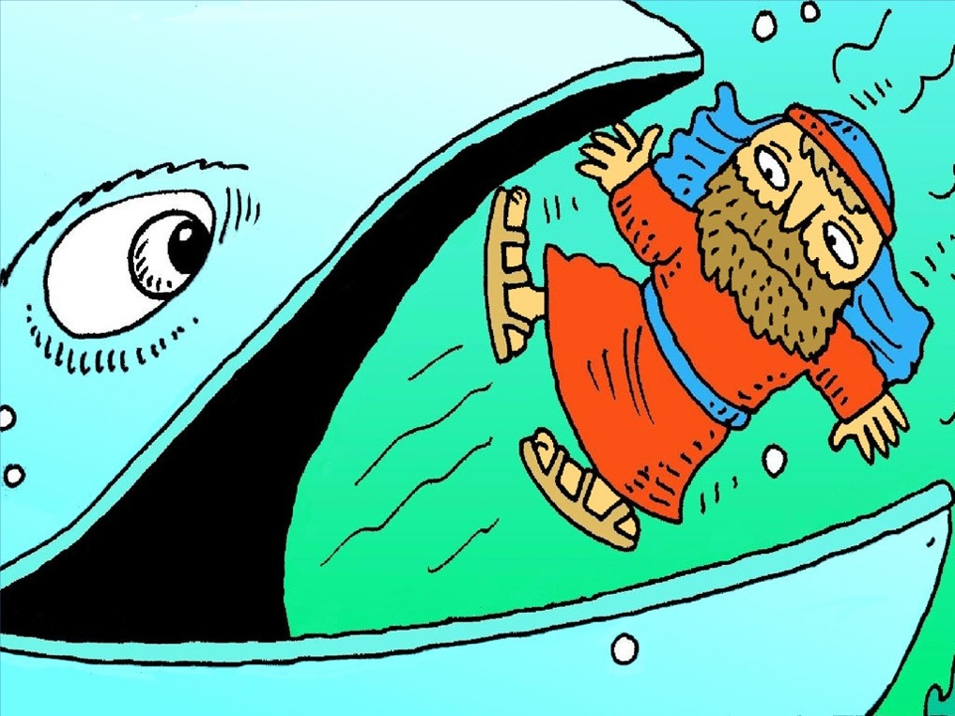
Week 1
SWALLOWED!
Image courtesy of: www.lambsongs.co.nz

Slide 14
Week 1
memory
verse
“When I was in trouble, LORD, I prayed to you, and you listened to me.” - Jonah 2:2a

Slide 15
Week 1
memory
verse
“When I was in trouble, LORD, I prayed to you, and you listened to me.” - Jonah 2:2a

Slide 16
Week 1
memory
verse
“When I was in trouble, LORD, I prayed to you, and you listened to me.” - Jonah 2:2a

Slide 17
Week 1
memory
verse
“When I was in trouble, LORD, I prayed to you, and you listened to me.” - Jonah 2:2a

Slide 18
Week 1
memory
verse
“When I was in trouble, LORD, I prayed to you, and you listened to me.” - Jonah 2:2a

Slide 19
Week 2

Slide 20
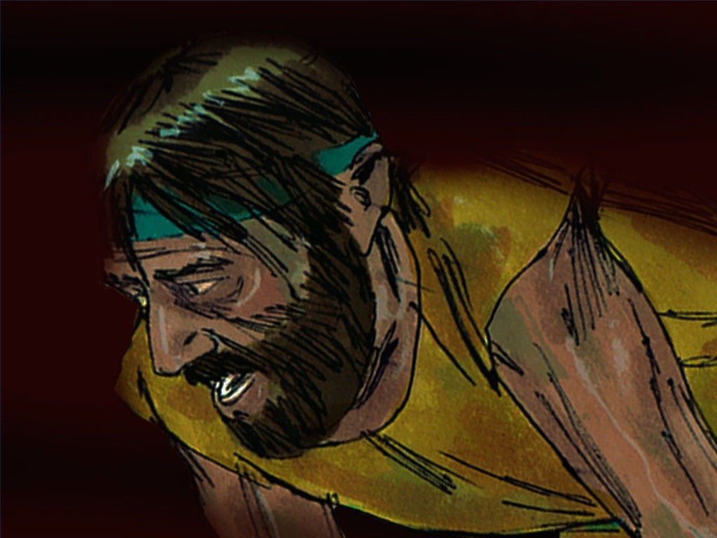
Week 2
JONAH TRAPPED
Image courtesy of: Sweet Publishing / FreeBibleimages.org

Slide 21
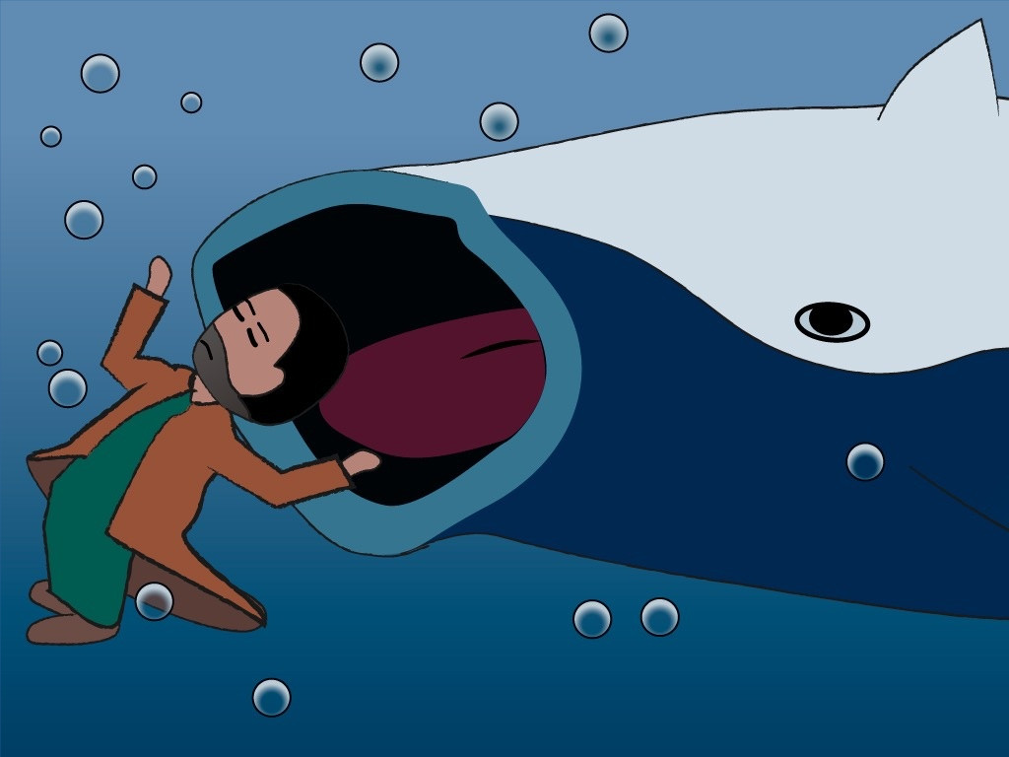
Week 2
JONAH SWALLOWED
Image courtesy of: Marian van der Kruijt

Slide 22
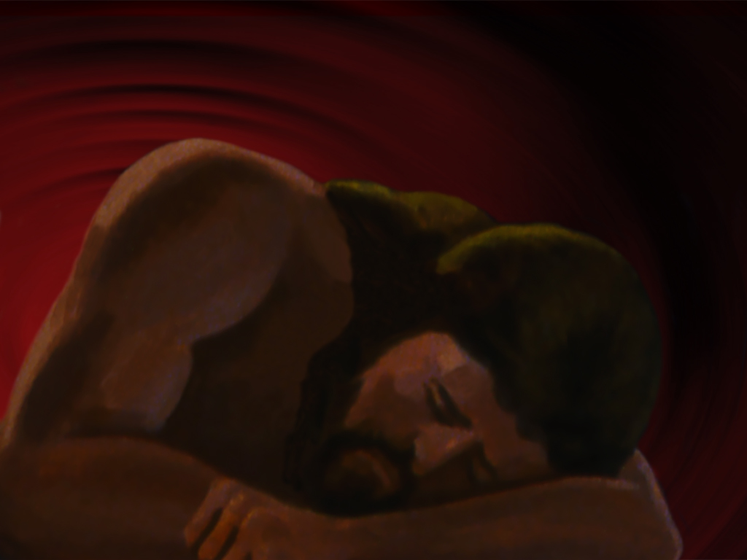
Week 2
JONAH PRAYS
Image courtesy of: Moody Publishers / FreeBibleimages.org

Slide 23
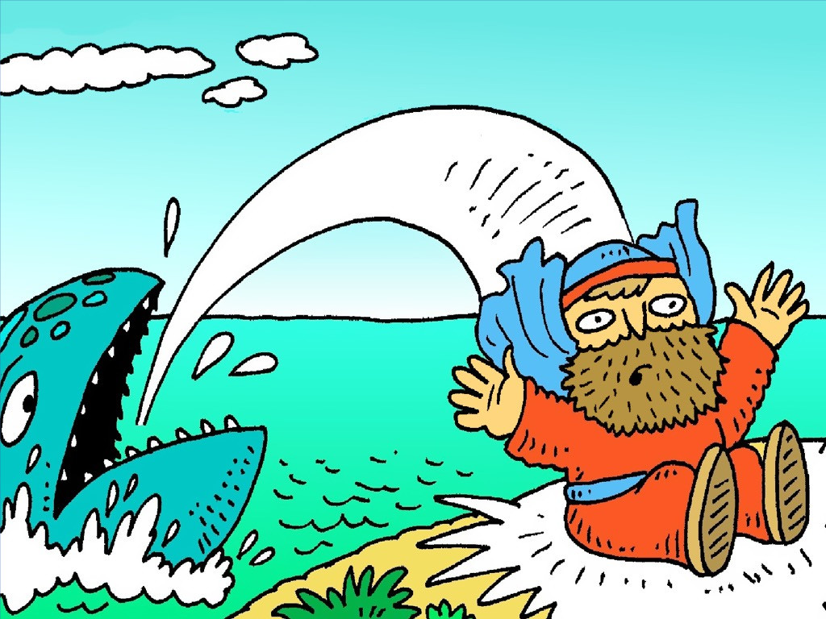
Week 2
JONAH VOMITED OUT
Image courtesy of: www.lambsongs.co.nz

Slide 24
Week 2
“When I was in trouble, LORD, I prayed to you, and you listened to me.” - Jonah 2:2a

Slide 25
Week 2
“When I was in trouble, LORD, I prayed to you, and you listened to me.” - Jonah 2:2a

Slide 26
Week 2
“When I was in trouble, LORD, I prayed to you, and you listened to me.” - Jonah 2:2a

Slide 27
Week 2
“When I was in trouble, LORD, I prayed to you, and you listened to me.” - Jonah 2:2a

Slide 28
Week 2

Slide 29
Week 3

Slide 30
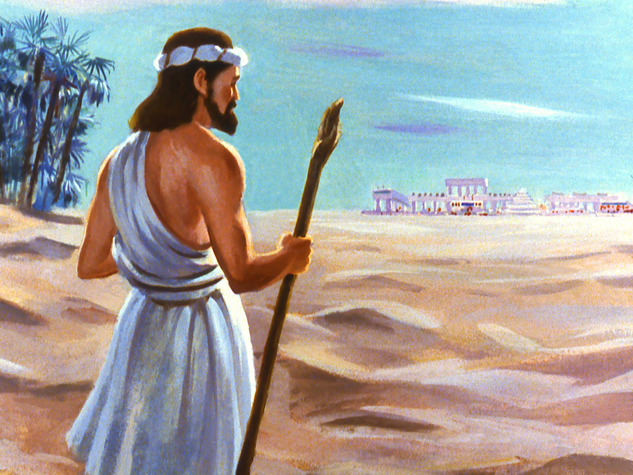
Week 3
JONAH GOES TO NINEVEH
Image courtesy of: Moody Publishers / FreeBibleimages.org

Slide 31
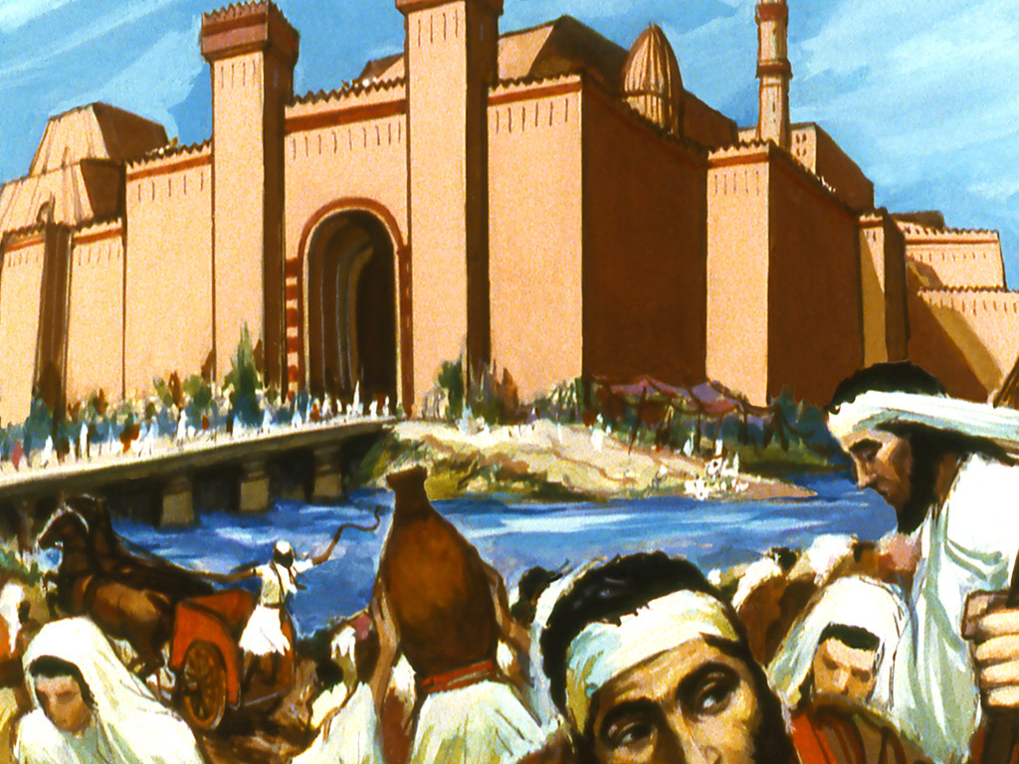
Week 3
THE CITY OF NINEVEH
Image courtesy of: Moody Publishers / FreeBibleimages.org

Slide 32
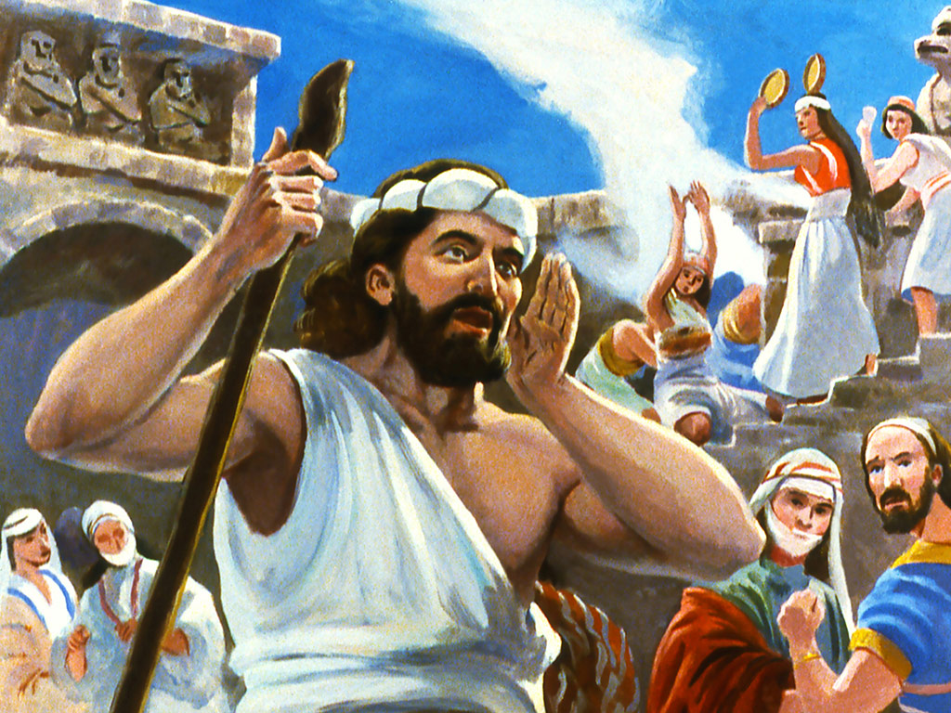
Week 3
JONAH’S MESSAGE
Image courtesy of: Moody Publishers / FreeBibleimages.org

Slide 33
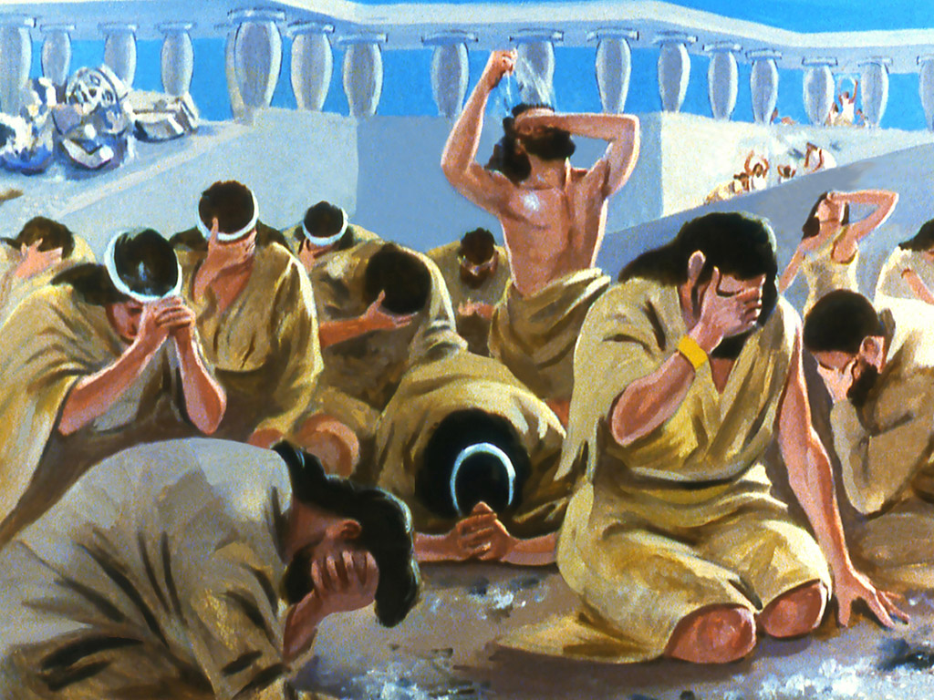
Week 3
THE PEOPLE RESPOND
Image courtesy of: Moody Publishers / FreeBibleimages.org

Slide 34
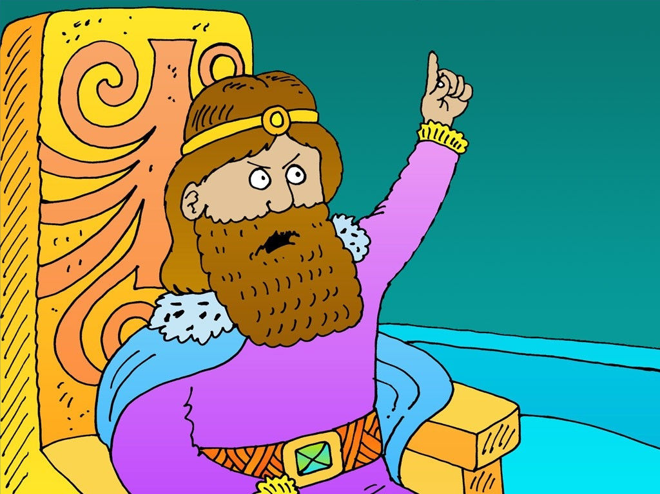
Week 3
THE KING RESPONDS
Image courtesy of: Richard Gunther

Slide 35
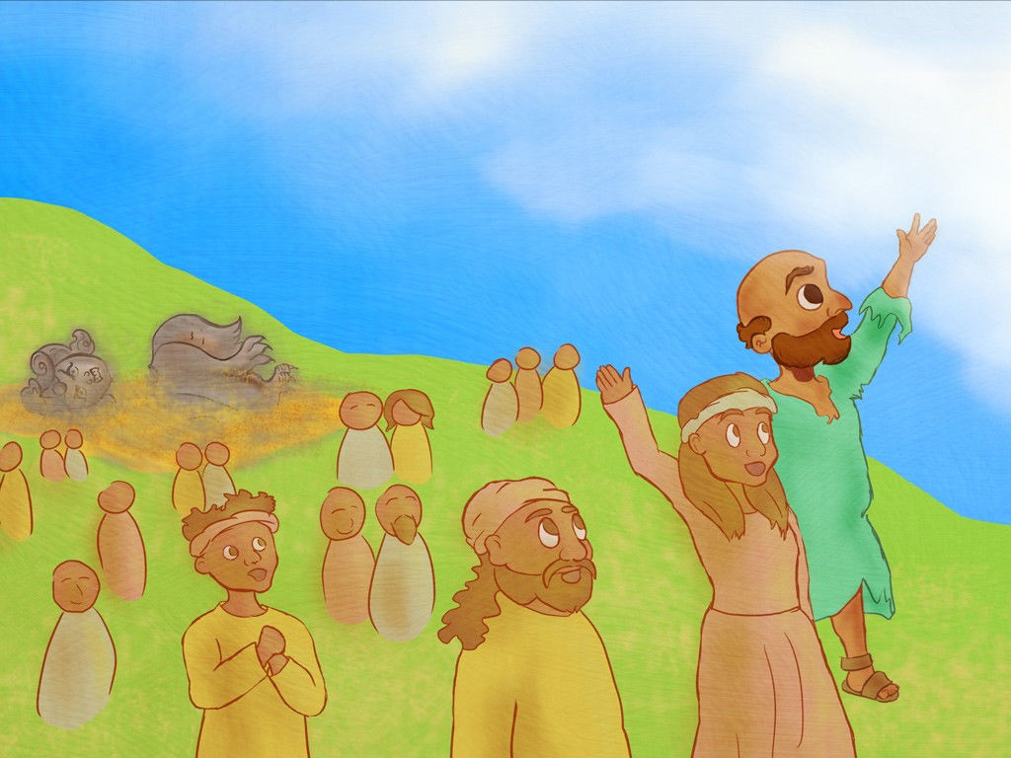
Week 3
THE PEOPLE ARE SAVED
Image courtesy of: www.fishnetbiblestories.com

Slide 36
Week 3
“When I was in trouble, LORD, I prayed to you, and you listened to me.” - Jonah 2:2a

Slide 37
Week 3
“When I was in trouble, LORD, I prayed to you, and you listened to me.” - Jonah 2:2a

Slide 38
Week 3
“When I was in trouble, LORD, I prayed to you, and you listened to me.” - Jonah 2:2a

Slide 39
Week 3
“When I was in trouble, LORD, I prayed to you, and you listened to me.” - Jonah 2:2a

Slide 40
Week 3

Slide 41
Week 4

Slide 42
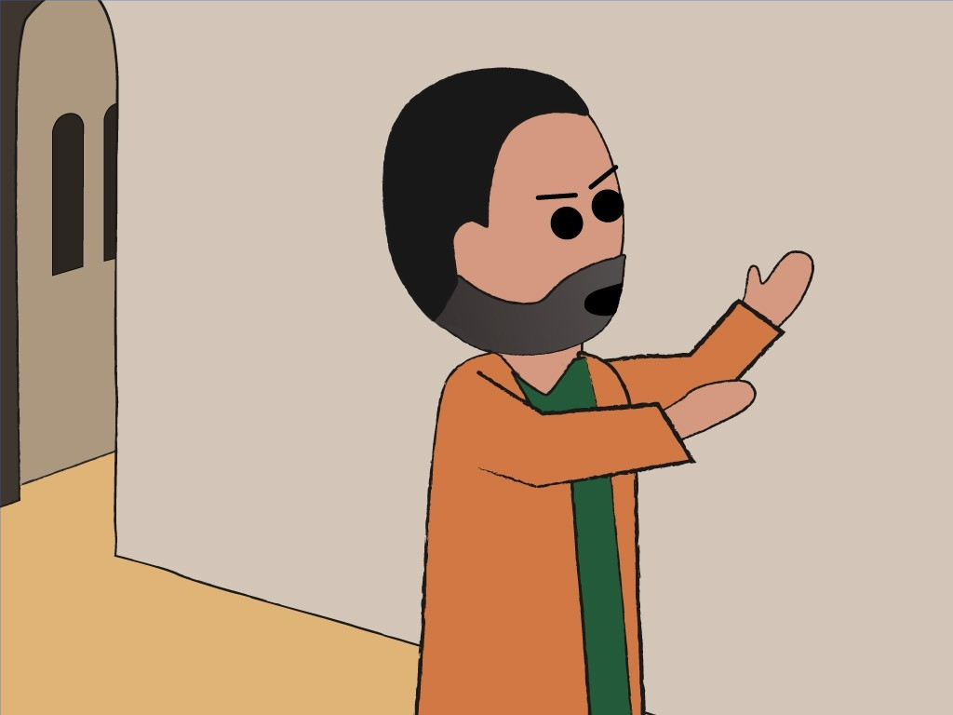
Week 4
JONAH IS ANGRY
Image courtesy of: www.fishnetbiblestories.com

Slide 43
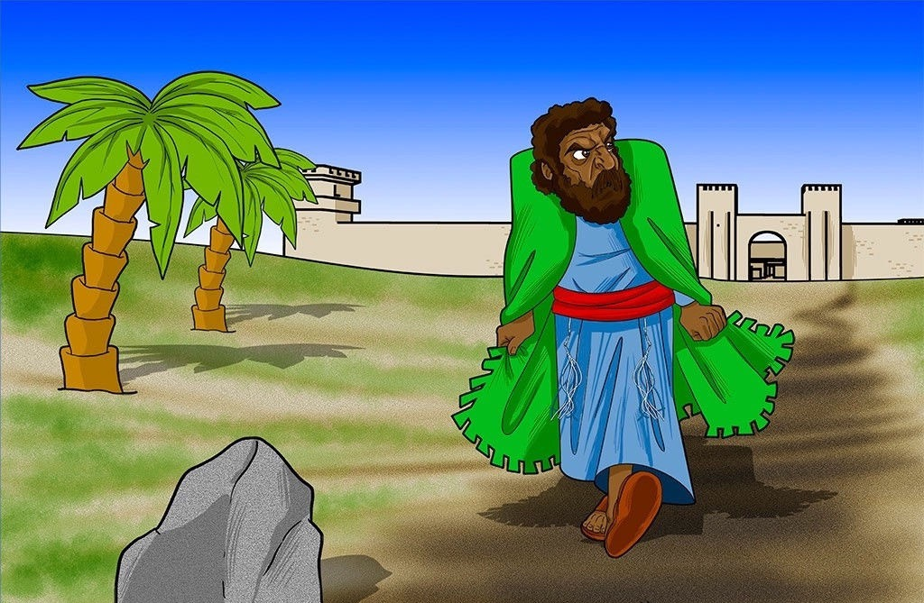
Week 4
JONAH STORMS OFF
Image courtesy of: BiblePathwayAdventures.com

Slide 44
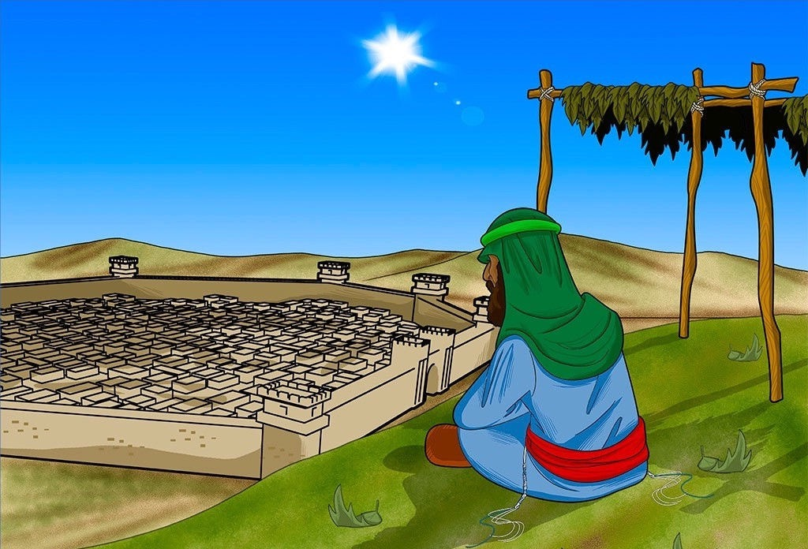
Week 4
JONAH WATCHES THE CITY
Image courtesy of: BiblePathwayAdventures.com

Slide 45
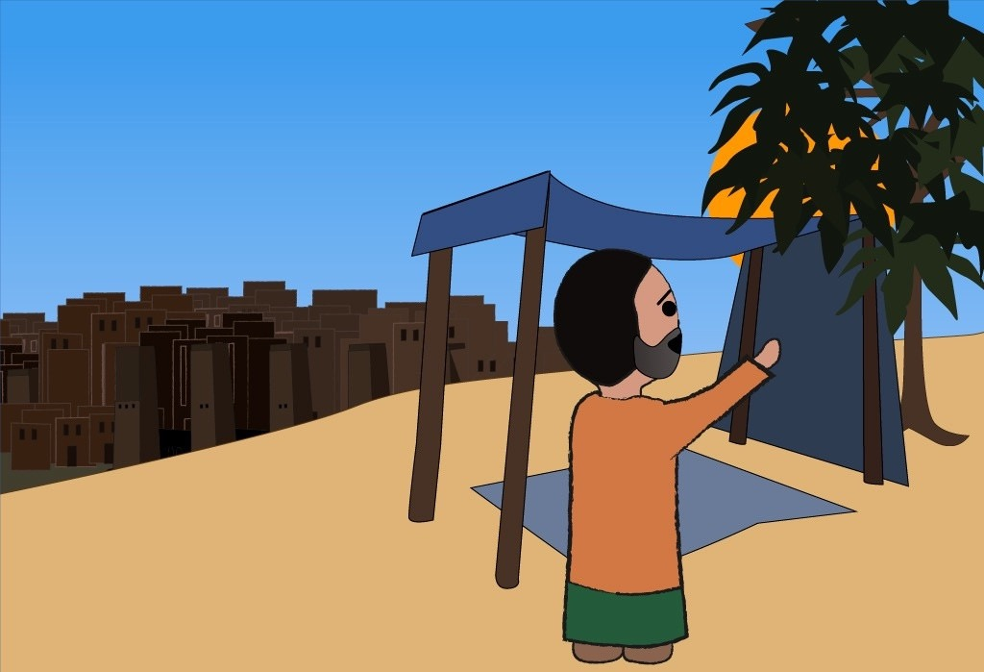
Week 4
GOD SENDS A VINE
Image courtesy of: www.fishnetbiblestories.com

Slide 46
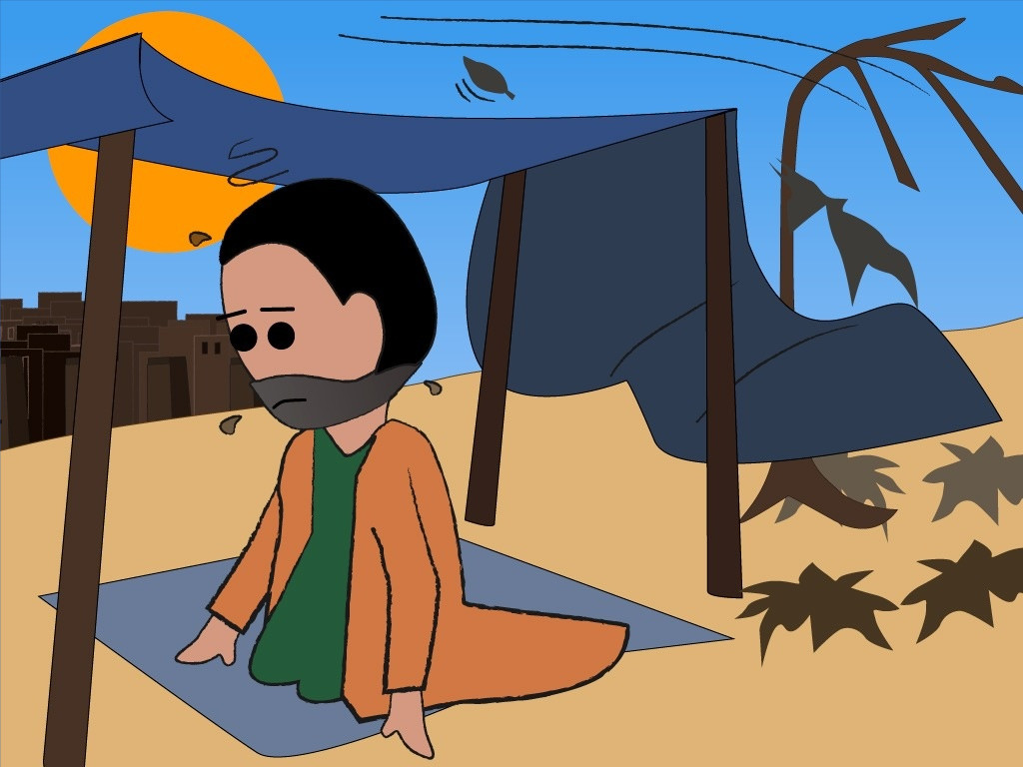
Week 4
THE VINE IS DESTROYED
Image courtesy of: www.fishnetbiblestories.com

Slide 47
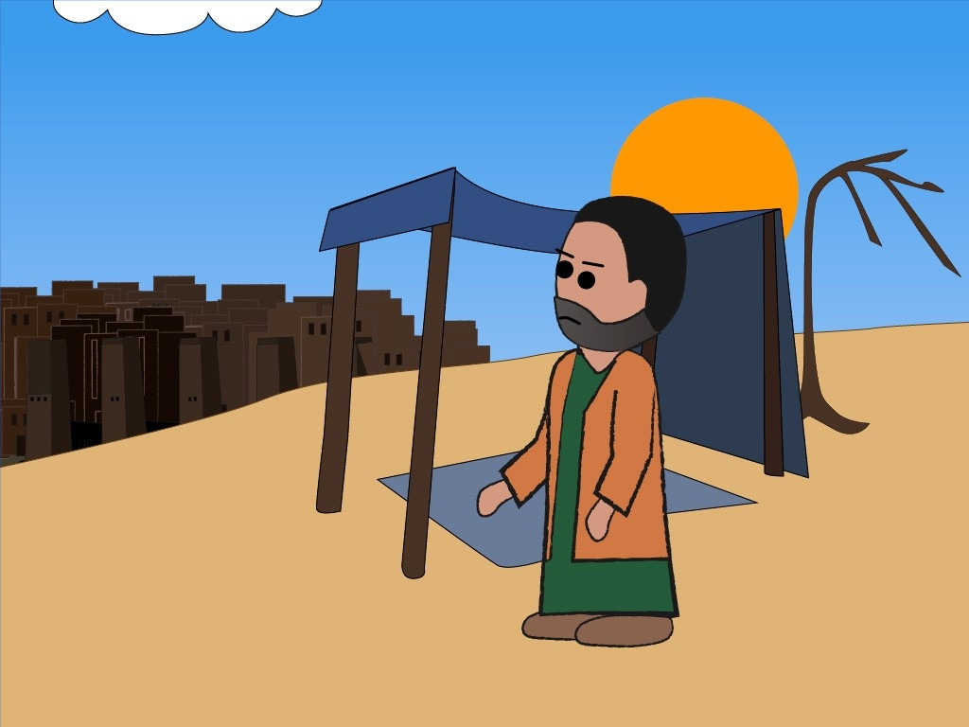
Week 4
JONAH IS UPSET
Image courtesy of: www.fishnetbiblestories.com

Slide 48
Week 4
“When I was in trouble, LORD, I prayed to you, and you listened to me.” - Jonah 2:2a

Slide 49
Week 4
“When I was in trouble, LORD, I prayed to you, and you listened to me.” - Jonah 2:2a

Slide 50
Week 4
“When I was in trouble, LORD, I prayed to you, and you listened to me.” - Jonah 2:2a

Slide 51
Week 4
“When I was in trouble, LORD, I prayed to you, and you listened to me.” - Jonah 2:2a

Slide 52
Week 4

Slide 53
Scripture taken from the Contemporary English Version © 1991, 1992, 1995 by American Bible Society, Used by Permission.

